Slide 1




Healthcare Revenue Cycle Management(RCM)
-Durga Prasad Raju Balaraju

Slide 2
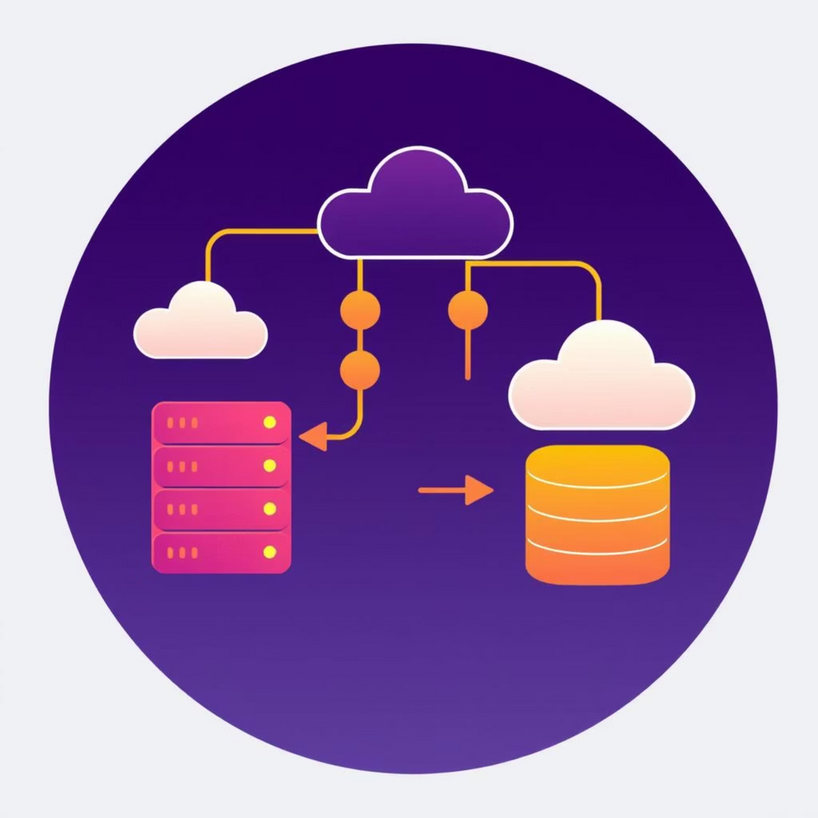
Agenda: Key Pillars of Data Engineering in RCM
Database Integration (MySQL + Python)
Data Quality Management
ETL Pipeline Development
Dimensional Modeling (Star Schema)
SCD Type 2 for historical tracking
BigQuery Cloud Warehousing

Slide 3




Learning Outcomes: Mastering Key Data Engineering Concepts
ETL Pipeline Development
Database Integration
Build robust ETL processes for extraction, complex transformations, and efficient loading into cloud warehouses, structuring workflows for maintainability.
Connect to and extract data from multiple MySQL databases using Python, managing connections and handling errors effectively.
Data Quality Management
Dimensional Data Modeling
Implement validation rules, cleansing techniques, quality scoring, and robust error handling for data integrity.
Design efficient star schemas for analytics, constructing fact tables and managing dimensions with surrogate keys.

Slide 4


Learning Outcomes: Mastering Key Data Engineering Concepts (Cont.)
Slowly Changing Dimensions (SCD)
Cloud Data Warehousing
Understand BigQuery architecture, optimize schema design with partitioning and clustering, and manage costs effectively.
Implement SCD Type 2 logic to track historical data changes, manage version control, and optimize for large-scale processing.

Slide 5
Technical Requirements: Building a Robust Data Pipeline
Historical Data & Analytics Infrastructure
Data Integration & Quality
Extract patient, provider, and transaction data from two MySQL databases.
Implement Slowly Changing Dimension (SCD) Type 2 for patient data.
Process monthly insurance claims from CSVs.
Load processed data into Google BigQuery for scalable analytics.
Maintain audit trails for compliance.
Implement comprehensive data validation and cleansing.
Create a dimensional model (fact & dimension tables) for self-service analytics.
Standardize patient identifiers and establish data quality scoring.

Slide 6
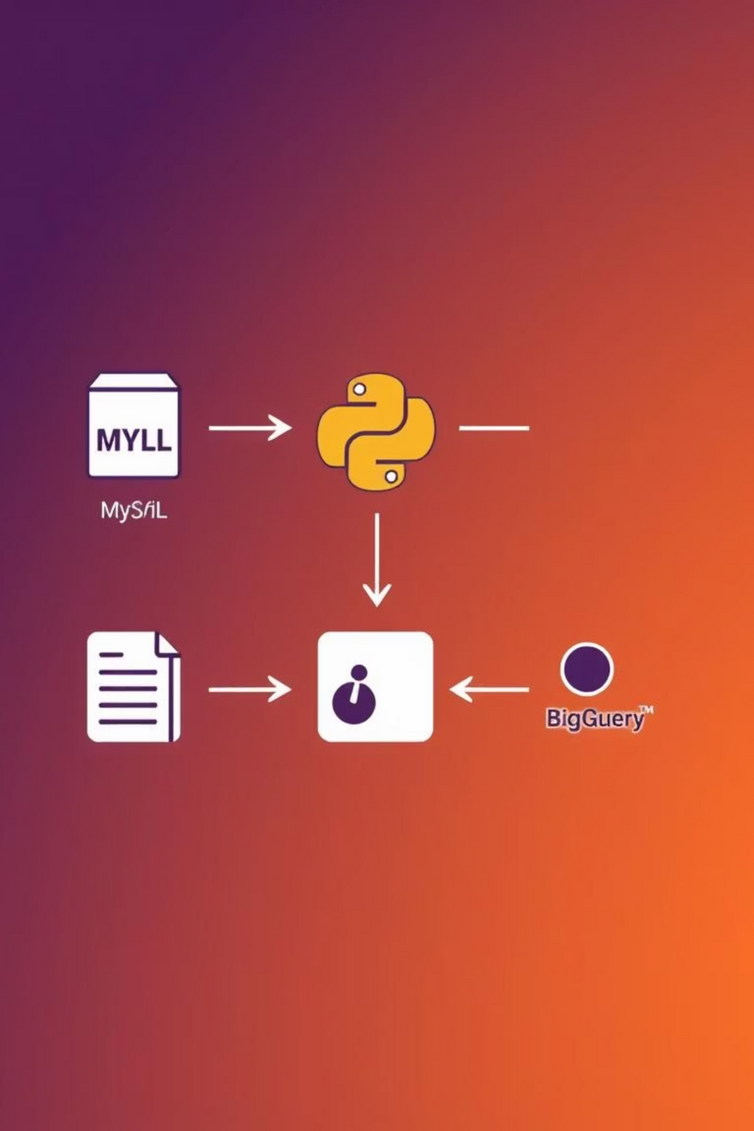
Architecture: The RCM Data Pipeline Flow
This diagram illustrates the comprehensive data flow from disparate source systems, through Python-driven ETL processes, culminating in a BigQuery data warehouse designed for robust RCM analytics.

Slide 7
Project Workflow: A Step-by-Step Implementation Guide
1. Environment Setup
Install MySQL, set up Google Cloud Project & BigQuery, and configure Python with necessary libraries.
2. Data Extraction
Develop a DataExtractor to pull patient/transaction data from MySQL and process claims CSVs.
3. Data Transformation
Implement data quality/cleansing, apply business logic, and build a Common Data Model.
4. Dimensional Modeling
Create dimension tables (patients, providers, procedures, date) and fact tables (transactions, claims).
5. SCD Type 2 Implementation
Develop logic for Slowly Changing Dimension Type 2 on patient data, tracking historical changes.
6. BigQuery Integration
Create BigQuery schemas with partitioning/clustering, load tables, and perform data validation.
7. RCM Analytics
Write SQL queries to calculate key RCM KPIs and generate data quality reports.

Slide 8
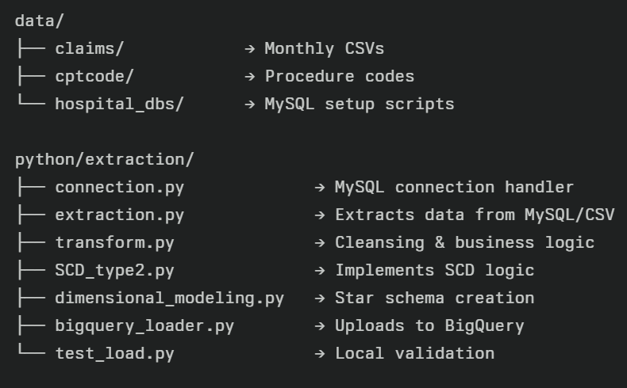
Directory Structure with File Functions

Slide 9
ETL in Detail: Extract & Transform Stages
Extract
Transform
Pull data from various source systems: MySQL databases (Hospital A & B) and CSV files (monthly insurance claims).
Clean and standardize raw data: proper case names, email validation, phone format normalization, age calculation from DOB.
Utilizes connection.py and extraction.py.
Mapping statuses like "Partial" or "Denied" and implementing business logic in transform.py.
Ensures secure, reliable connection and handles source heterogeneity.
Flags and filters poor-quality records.

Slide 10
Dimensional Modeling: Optimizing for Analytics
Dimensional modeling is a data design technique optimized for data warehousing and analytics. Instead of focusing on normalization (like OLTP systems), it focuses on making data:
Easy to query
Fast to aggregate
Two Types:
Table Type
Table Name
Description
Fact Table
fact_transactions
One row per billing transaction
Fact Table
fact_claims
One row per insurance claim
Dimension
dim_patients
Demographics, insurance info
Dimension
dim_providers
Doctor or hospital details
Dimension
dim_procedures
Procedure codes (e.g., CPT codes)
Dimension
dim_date
Calendar breakdown (day, month, quarter)

Slide 11
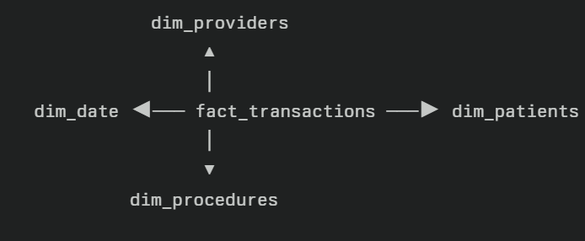
Star Schema
A central Fact Table connected to multiple Dimension Tables
Named "star" because the layout looks like a star 🌟
SCD Type 2 Implementation (Tracking Patient Data Changes)
Purpose: Keep a history of changes in patient information (like address or insurance) over time.
How it works:
When patient info changes, the old record is marked as expired, and a new record with updated info is added.
Each record shows when it was effective and when it expired, plus a flag showing the current active record.
Benefit: You can see what data looked like at any point in time, which helps with auditing and analysis.

Slide 12
BigQuery Integration (Loading & Managing Data in Cloud)
Schema: Create tables organized for easy querying (fact and dimension tables).
Partitioning: Split big tables by date so queries are faster and cheaper.
Clustering: Group data by key fields (like patient or hospital IDs) to quickly filter rows.
Incremental Loads: Only load new or changed data each time, instead of all data again.
Validation: Check data quality and consistency after loading to ensure accuracy.
RCM Analytics (Measuring Revenue Cycle Performance)
Revenue Metrics: Calculate total payments collected over time, by hospital, etc.
Claims Performance: Track how many claims are approved or denied and how fast they’re processed.
Operational KPIs: Measure efficiency areas like how quickly patients pay or how much money is
written off.
Data Quality Checks: Monitor for missing or incorrect data to keep reports accurate.
Dashboards: Visual displays for stakeholders to understand key performance and trends easily.

Slide 13


